Slide 1


CSB1303– OBJECT ORIENTED ANALYSIS AND DESIGN PROJECT REVIEW
Department of Computer Science and Engineering
Academic Year: 2025 – 2026 (Odd Semester)
TEAM MEMBERS
S.S.VIJESH – 2303811710421178
P.YUVARAJ – 2303811710421188
S. SRIRAM - 2303811710421158
G.VIJAYA PRAKASH – 2303811710421176
V.S. VIJAYESWARAN – 2303811710421177

Slide 2
Title of the Project
VEHICLE PRE-BOOKING SYSTEM

Slide 3
ABSTRACT
The Vehicle Pre-Booking System is a web-based application. It allows users to rent vehicles, pre-book showroom vehicles, and book travel packages. The system provides AI-based trip planning and vehicle recommendations. Secure login and role-based access are implemented. An admin dashboard helps in monitoring bookings and revenue.

Slide 4
INTRODUCTION
The Vehicle Pre-Booking System is a web-based application designed to simplify the process of renting vehicles, pre-booking showroom vehicles, and booking travel packages. Traditional booking systems are often fragmented and time-consuming, requiring users to visit multiple platforms. This system provides a single, user-friendly platform with secure authentication and intelligent features. The integration of AI-based recommendations helps users select suitable vehicles and plan trips efficiently.

Slide 5
EXISTING SYSTEM
Manual searching and comparison of vehicles is required.
No intelligent recommendation or trip planning support.
Limited tracking of bookings and revenue.
Poor user experience and increased time consumption.
Separate platforms are used for rentals, showroom bookings, and travel packages.

Slide 6
PROPOSED SYSTEM
Users can rent vehicles, pre-book showroom vehicles, and book travel packages.
AI-based trip planner provides smart recommendations.
Dynamic price calculation and secure authentication are implemented.
Admin dashboard provides centralized monitoring and analytics.
A single integrated platform for all vehicle booking services.

Slide 7
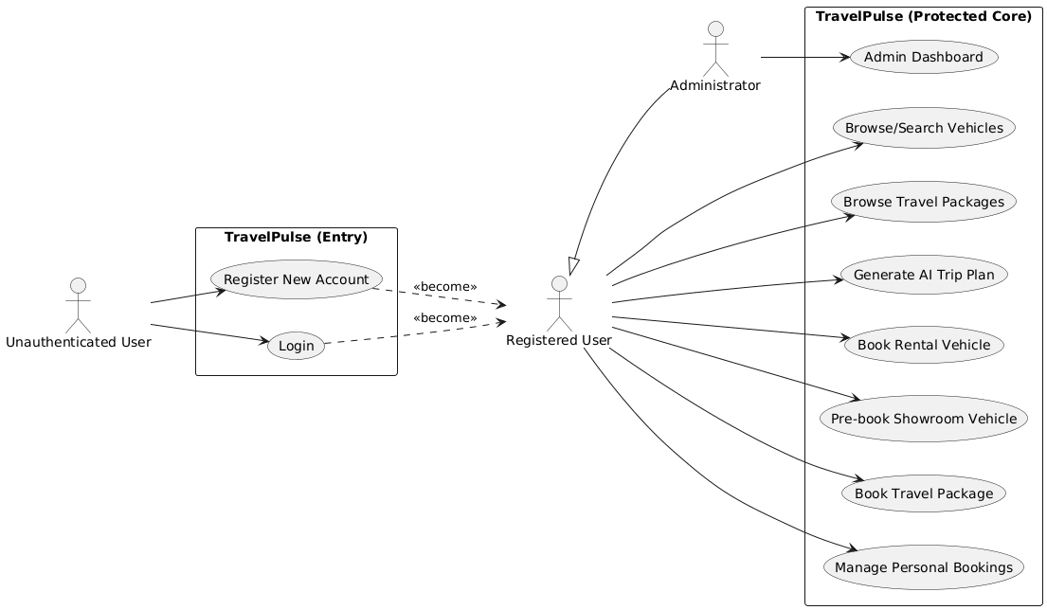
USE CASE MODEL

Slide 8
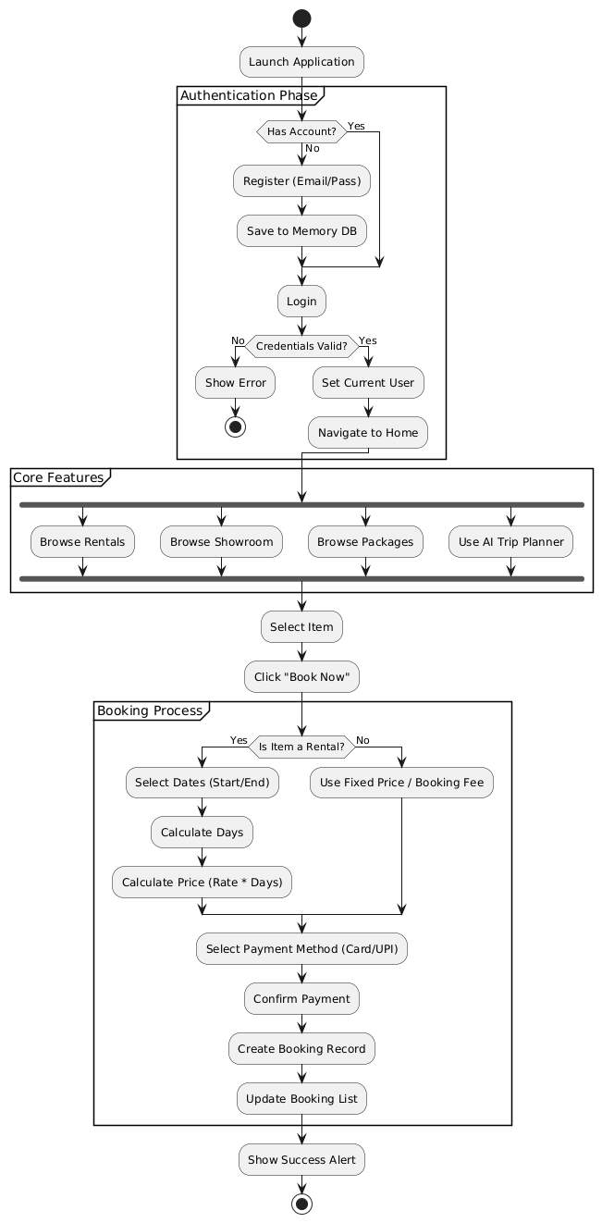
ACTIVITY DIAGRAM

Slide 9
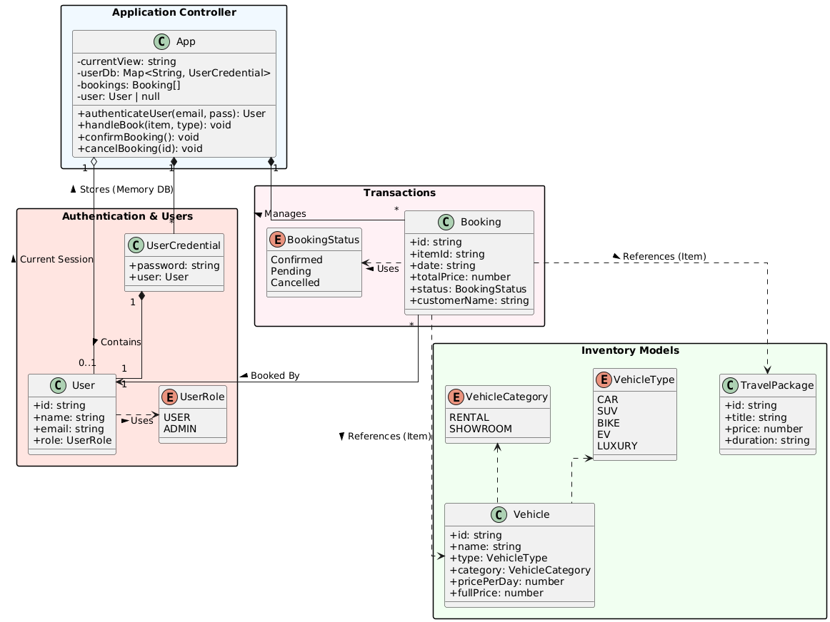
CLASS DIAGRAM

Slide 10
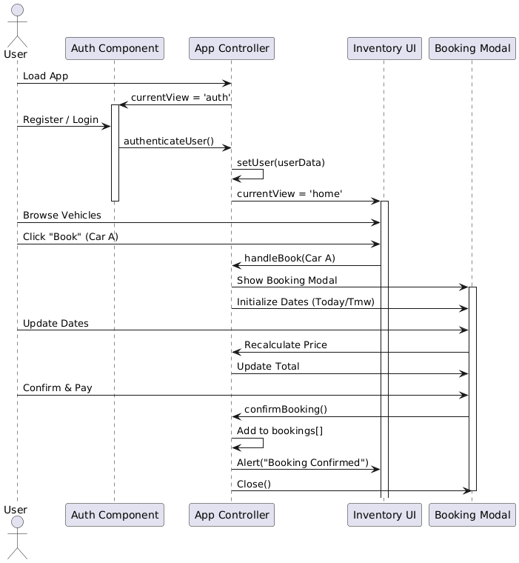
SEQUENCE DIAGRAM

Slide 11
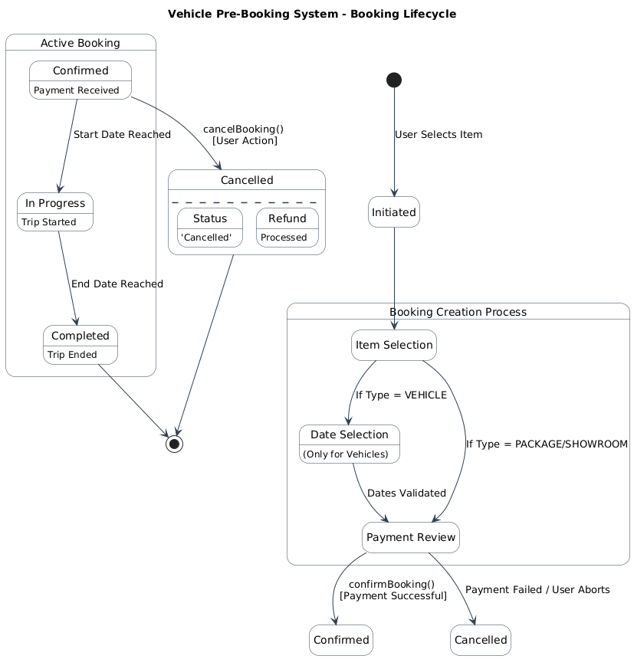
STATE MACHINE DIAGRAM

Slide 12
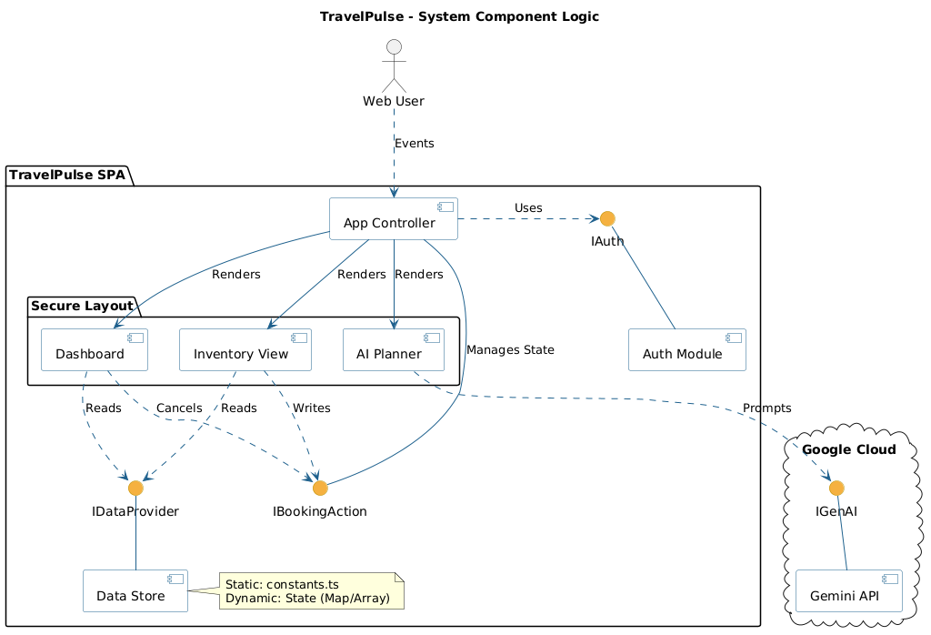
COMPONENT DIAGRAM

Slide 13
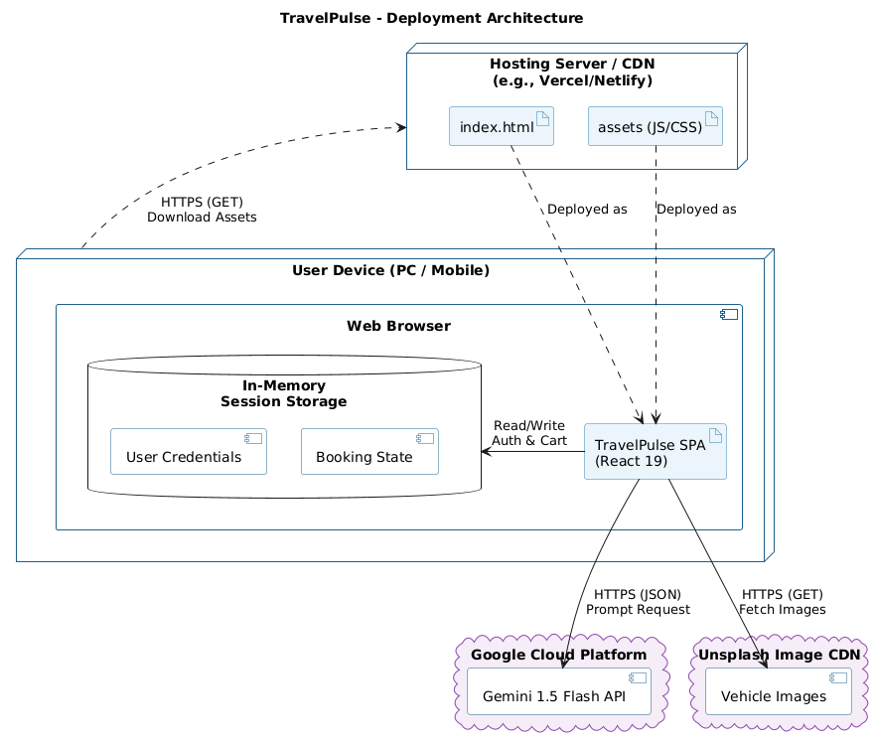
DEPLOYMENT DIAGRAM

Slide 14
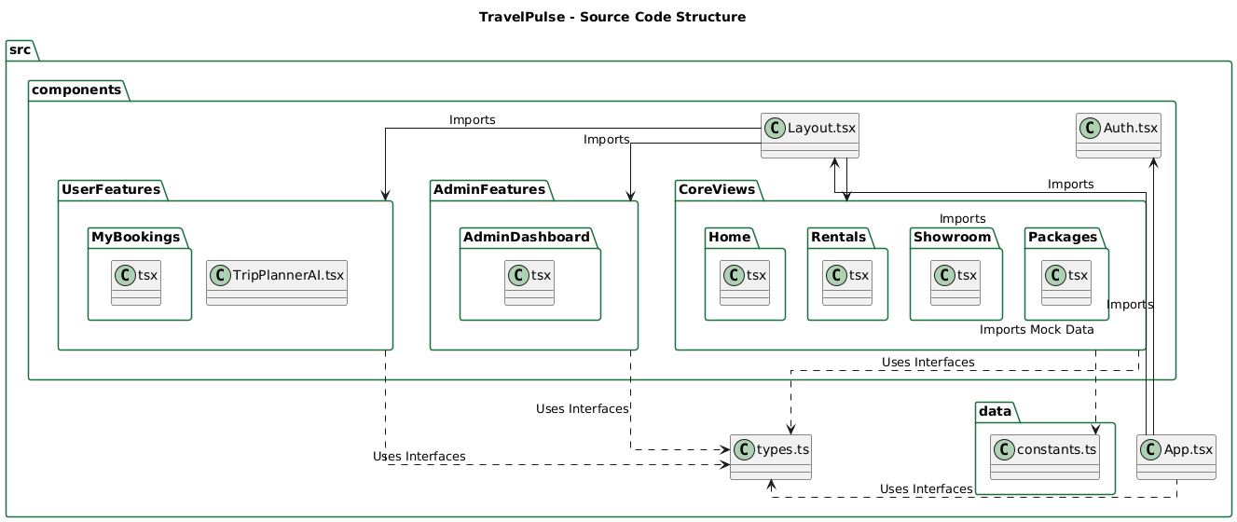
PACKAGE DIAGRAM

Slide 15
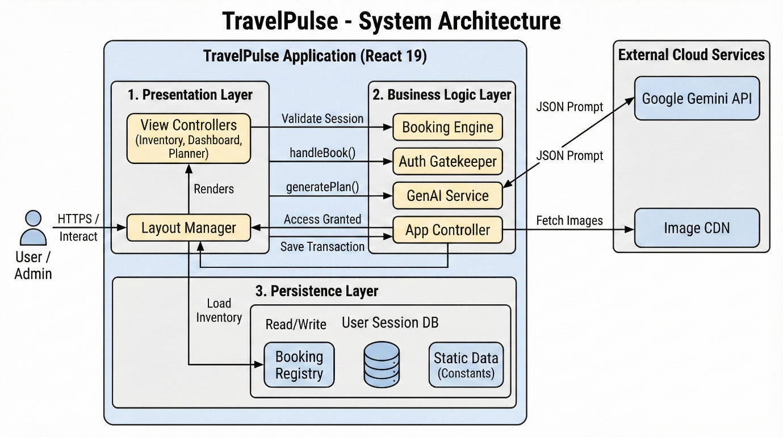
DESIGN PATTERN USED

Slide 16
MODULE DESIGN & IMPLEMENTATION
State Management and Controller Module
User Authentication and Registration Module
Vehicle Inventory and Display Module
Booking Management and Payment Module
AI Trip Planning and Recommendation Module
Admin Dashboard and Analytics Module

Slide 17
MODULE DESIGN & IMPLEMENTATION
State Management and Controller Module
This module acts as the central controller of the system. It manages the overall application state such as current view, user session, booking data, and navigation flow. It coordinates communication between different modules and ensures smooth operation of the system.
User Authentication and Registration Module
This module handles user registration and login functionality. It validates user credentials and ensures secure access to the system. Role-based access control is implemented to differentiate between users and administrators.

Slide 18
MODULE DESIGN & IMPLEMENTATION
Vehicle Inventory and Display Module
This module manages the display of rental vehicles, showroom vehicles, and travel packages. It allows users to browse, search, and filter vehicles based on category and type. Vehicle details such as price, availability, and specifications are displayed clearly.
Booking Management and Payment Module
This module handles the complete booking process. It allows users to select booking dates, calculates the total cost dynamically, and confirms bookings. It also manages booking status and supports cancellation when required.

Slide 19
MODULE DESIGN & IMPLEMENTATION
AI Trip Planning and Recommendation Module
This module provides AI-based travel planning assistance. It accepts user queries and generates travel suggestions and suitable vehicle recommendations. The module improves user decision-making and enhances the booking experience.
Admin Dashboard and Analytics Module
This module provides administrators with a centralized dashboard. It displays booking statistics, revenue details, and system activity. Admins can monitor performance, manage bookings, and analyze overall system usage.

Slide 20
SOURCE CODE IMPLEMENTATION
Index page:
import React from 'react';
import ReactDOM from 'react-dom/client';
import App from './App';
const rootElement = document.getElementById('root');
if (!rootElement)
{
throw new Error("Could not find root element to mount to");
}
const root = ReactDOM.createRoot(rootElement); root.render( );

Slide 21
SOURCE CODE IMPLEMENTATION
import React from "react";
import { MapPin, Calendar, Search, Car, CheckCircle } from "lucide-react";
import { MOCK_VEHICLES } from "../constants";
import { VehicleCategory, Vehicle } from "../types";
import VehicleCard from "./VehicleCard";
interface HomeProps {
user: any;
setView: (view: string) => void;
onBook: (vehicle: Vehicle, type: "VEHICLE") => void;
}
const Home: React.FC<HomeProps> = ({ user, setView, onBook }) => {

Slide 22
SOURCE CODE IMPLEMENTATION
{/* Hero + search */}
<section>
<h1>Vehicle Pre-Booking System</h1>
<p>Rent vehicles, pre-book showroom cars, and explore tour packages.</p>
<div>
<input type="text" placeholder="Where to?" />
<input type="date" />
<button onClick={() => setView("vehicles")}>
<Search /> Search
</button>
</div>
</section>

Slide 23
SOURCE CODE IMPLEMENTATION
{/* Services cards */}
<section>
<div onClick={() => setView("vehicles")}>
<Car /> Vehicle Rentals
</div>
<div onClick={() => setView("showroom")}>
<CheckCircle /> Showroom Pre-Booking
</div>
<div onClick={() => setView("packages")}>
<MapPin /> Trips & Tours
</div>
</section>

Slide 24
SOURCE CODE IMPLEMENTATION
{/* Popular rentals */}
<section>
<h2>Popular Rentals</h2>
{MOCK_VEHICLES
.filter(v => v.category === VehicleCategory.RENTAL)
.slice(0, 3)
.map(v => (
<VehicleCard
key={v.id}
vehicle={v}
onBook={veh => onBook(veh, "VEHICLE")}
isLoggedIn={!!user}

Slide 25
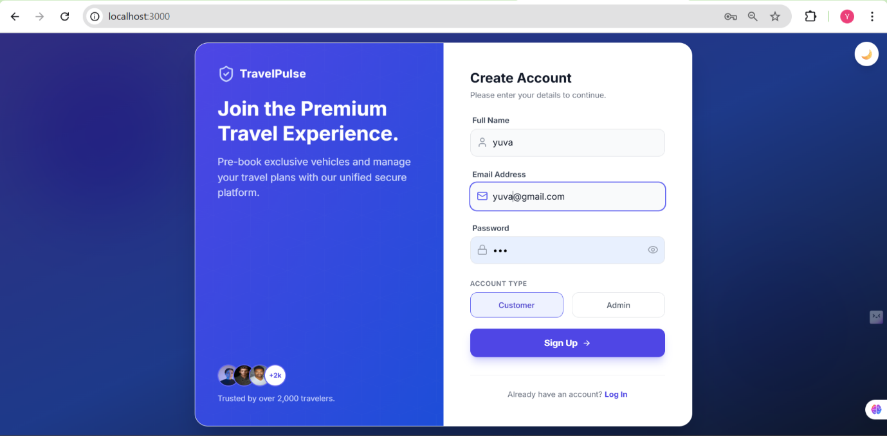
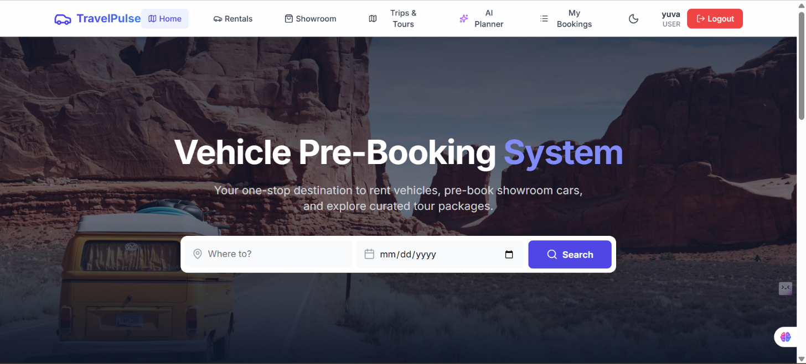
OUTPUT SCREENSHOTS
LOGIN PAGE: HOME PAGE:

Slide 26
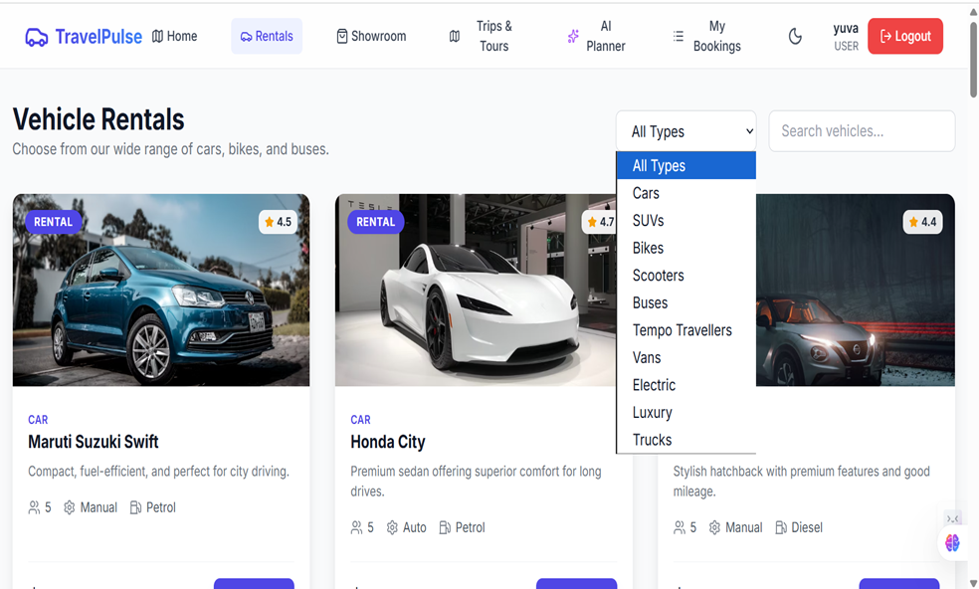
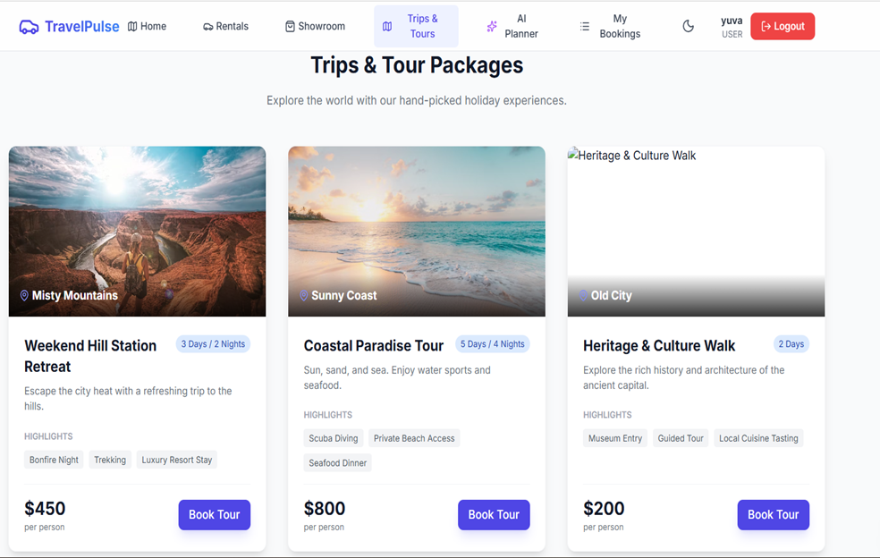
OUTPUT SCREENSHOTS
VEHICLE BOOKING: TRIP BOOKING PAGE:

Slide 27
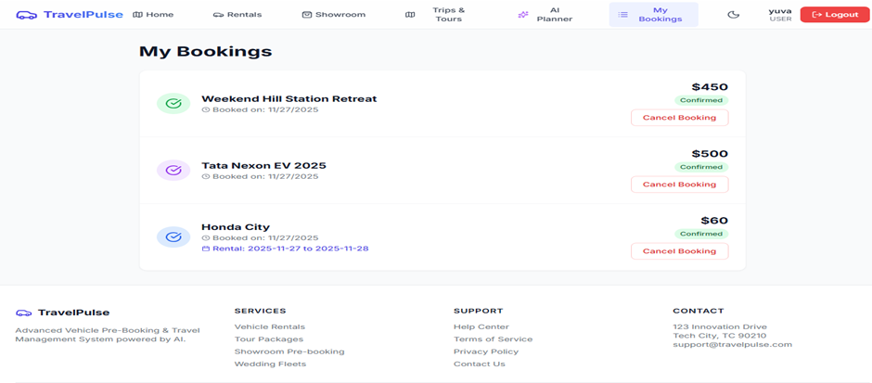
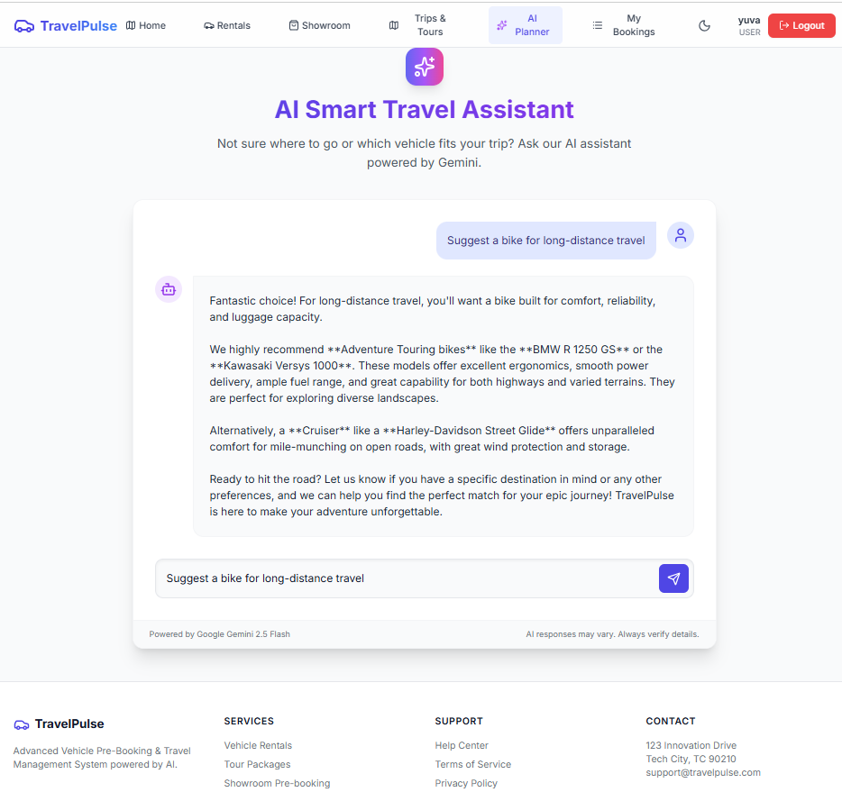
OUTPUT SCREENSHOTS
BOOKING DASHBOARD: AI SUGGESSTION:

Slide 28
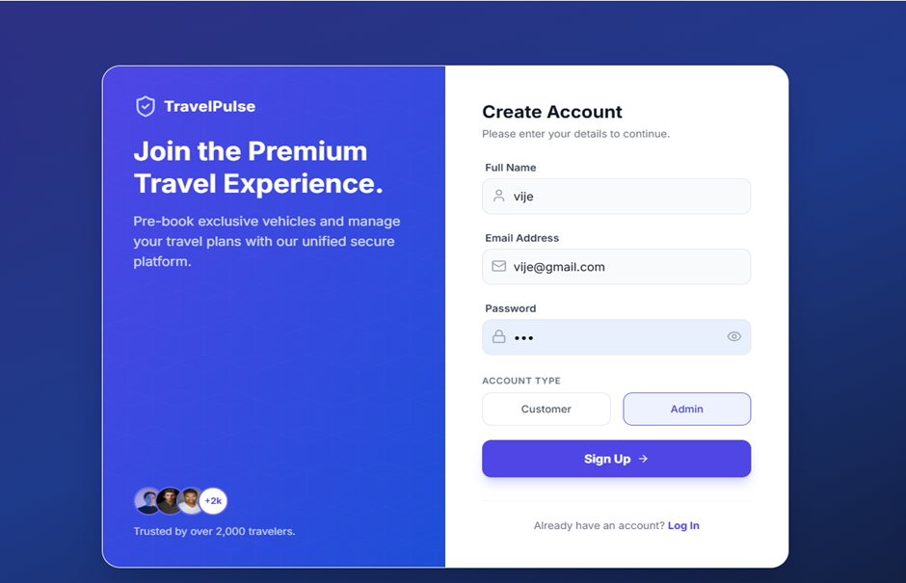
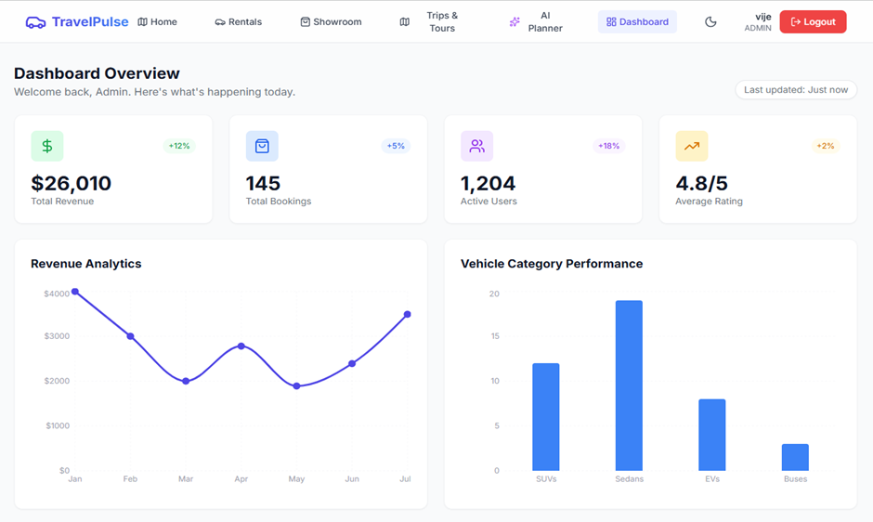
OUTPUT SCREENSHOTS
ADMIN LOGIN: ADMIN DASHBOARD:
:

Slide 29
Conclusion & Future Enhancements
Conclusion
The Vehicle Pre-Booking System project successfully demonstrates the development of a feature-rich, AI-integrated web application for managing vehicle and travel bookings. The system meets its core objectives by providing a unified platform for rentals, showroom pre-booking, and tour packages, enhanced with an intelligent trip planner.

Slide 30
Conclusion & Future Enhancements
Future Enhancements
The system can be further enhanced by integrating cloud-based storage for better scalability and reliability. Support for multiple languages and improved security features can be added. Real-time vehicle availability updates and smarter AI recommendations can also improve overall system performance and user satisfaction. Automated reports and advanced admin analytics can help in better decision-making.

Slide 31
Thank You
Any queries???

